Slide 2
Contents
Introduction
objective
• Project profile
• mod

Slide 3
INTRODUCTION
The primary use of a chat room is to share information via text with a group of other users. Generally speaking, the ability to converse with multiple people in the same conversation differentiates chat rooms from instant messaging programs, which are more typically designed for one-to-one communication. The users in a particular chat room are generally connected via a shared internet or other similar connection, and chat rooms exist catering for a wide range of subjects.

Slide 4
OBJECTIVE
The main objective of the Online Chat Application is to manage the details of Chat Application, Online Chat, Smiles Chat, Users, Chat History. It manages all the information about Chat Application, Chat Profile, Chat History, Chat Application. The purpose of the project is to build an application program to reduce the manual work for managing the Chat Application, Online Chat, Chat Profile, Smiles Chat. It tracks all the details about the Smiles Chat, Users, Chat History.

Slide 5
PROJECT PROFILE
Group Members:- | Shubham Kumar Yadav.
Project Title:- | “Online Chatting Application.”
College Guide Name:-
Hardware Configuration:- | HARD DISK:- 1TB RAM:8GB.
Software Configuration:- | Microsoft Edge.
Operating System:- | Windows 11.
Platform:- | Android Studio(Electric Eel | 2022.1.1) , Figma and Firebase
Project Technology:- | Android Studio, Kotlin, Firebase, Figma.
Front End:- | Android Studio and Figma.
Back End:- | Kotlin.
Database:- | Firebase.

Slide 6
FRONT-END
HTML (Hypertext Markup Language).
CSS (Cascading Style Sheets).
BOOTSTRAP.
AJAX (Asynchronous JavaScript and XML).
JavaScript.

Slide 7
BACK-END
PHP (Hypertext Preprocessor).
PHPMYADMIN.

Slide 8
MoDELs
Incremental Model :-
Incremental Model is a process of software development where requirements divided into multiple standalone modules of the software development cycle. In this model, each module goes through the requirements, design, implementation and testing phases. Every subsequent release of the module adds function to the previous release. The process continues until the complete system achieved.

Slide 9
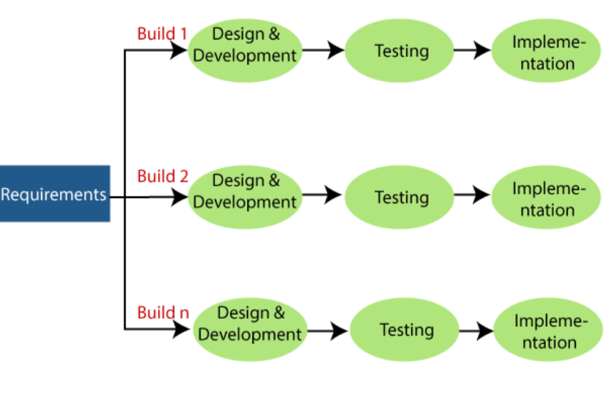
Incremental Model

Slide 10
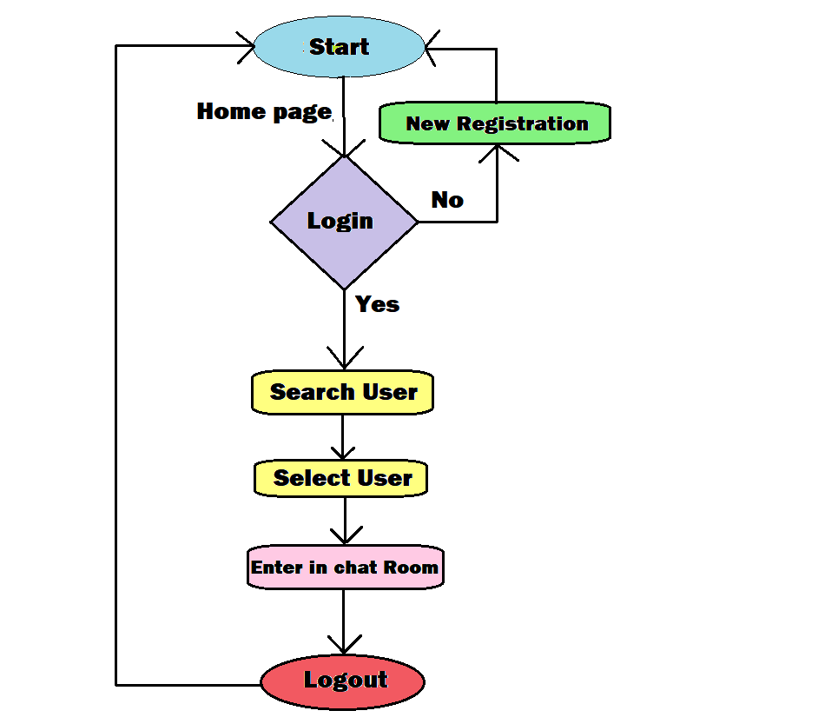
SYSTEM FLOW CHART

Slide 11
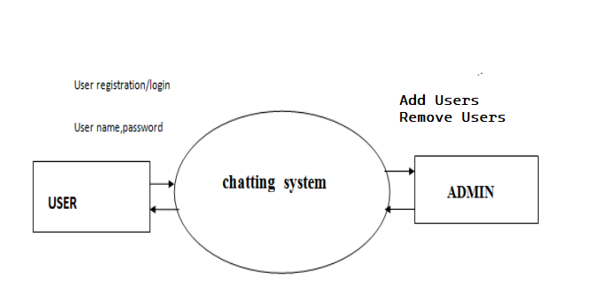
DFD DIGRAM
Zero Level:-
Zero Level DFD.

Slide 12
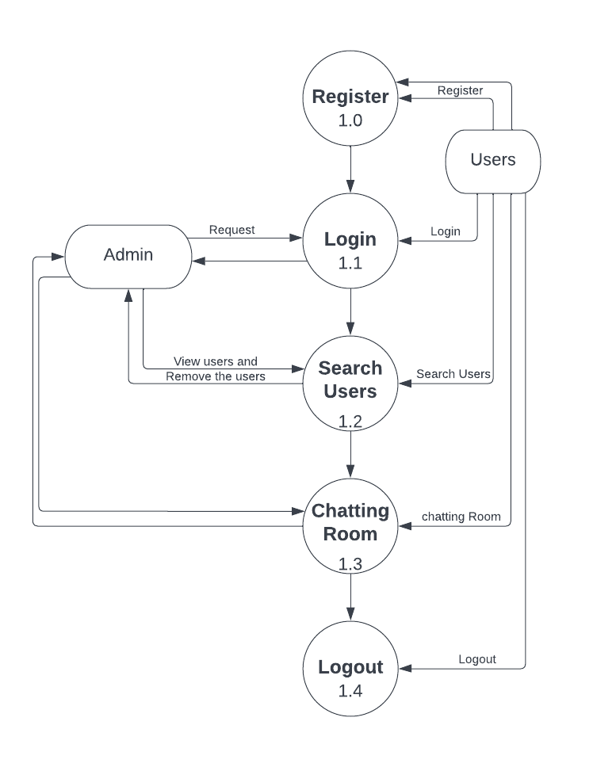
First Level:-
First Level DFD.

Slide 13
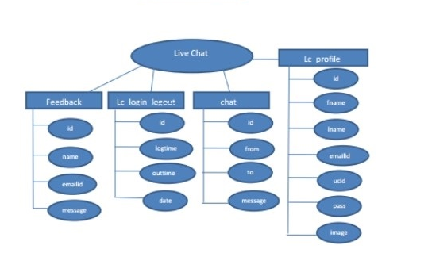
ER DIAGRAM(ENTITY RELATIONSHIP DIAGRAM):-

Slide 14
SCREENSHOTS

Slide 15
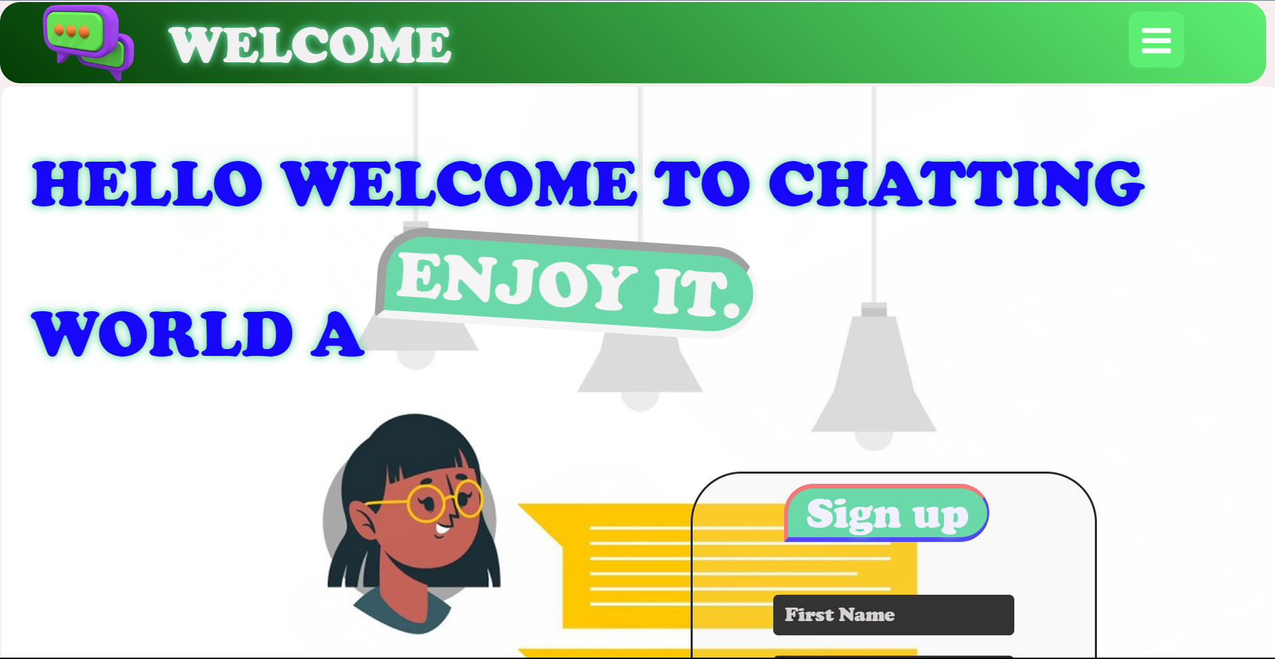
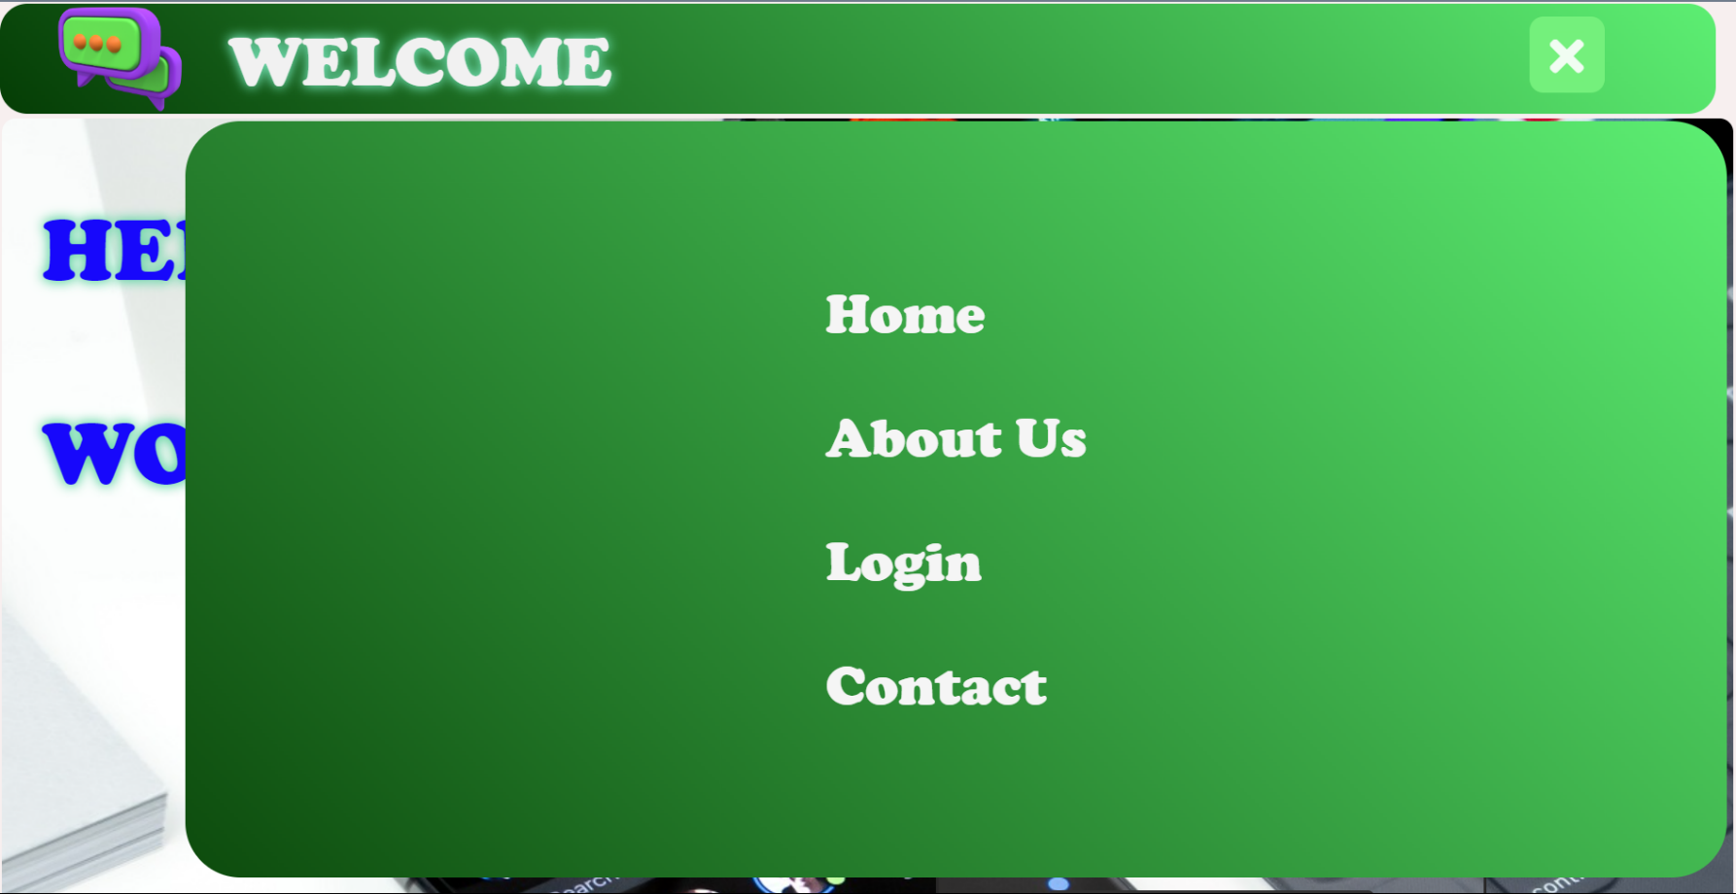
HOME PAGE:-

Slide 16
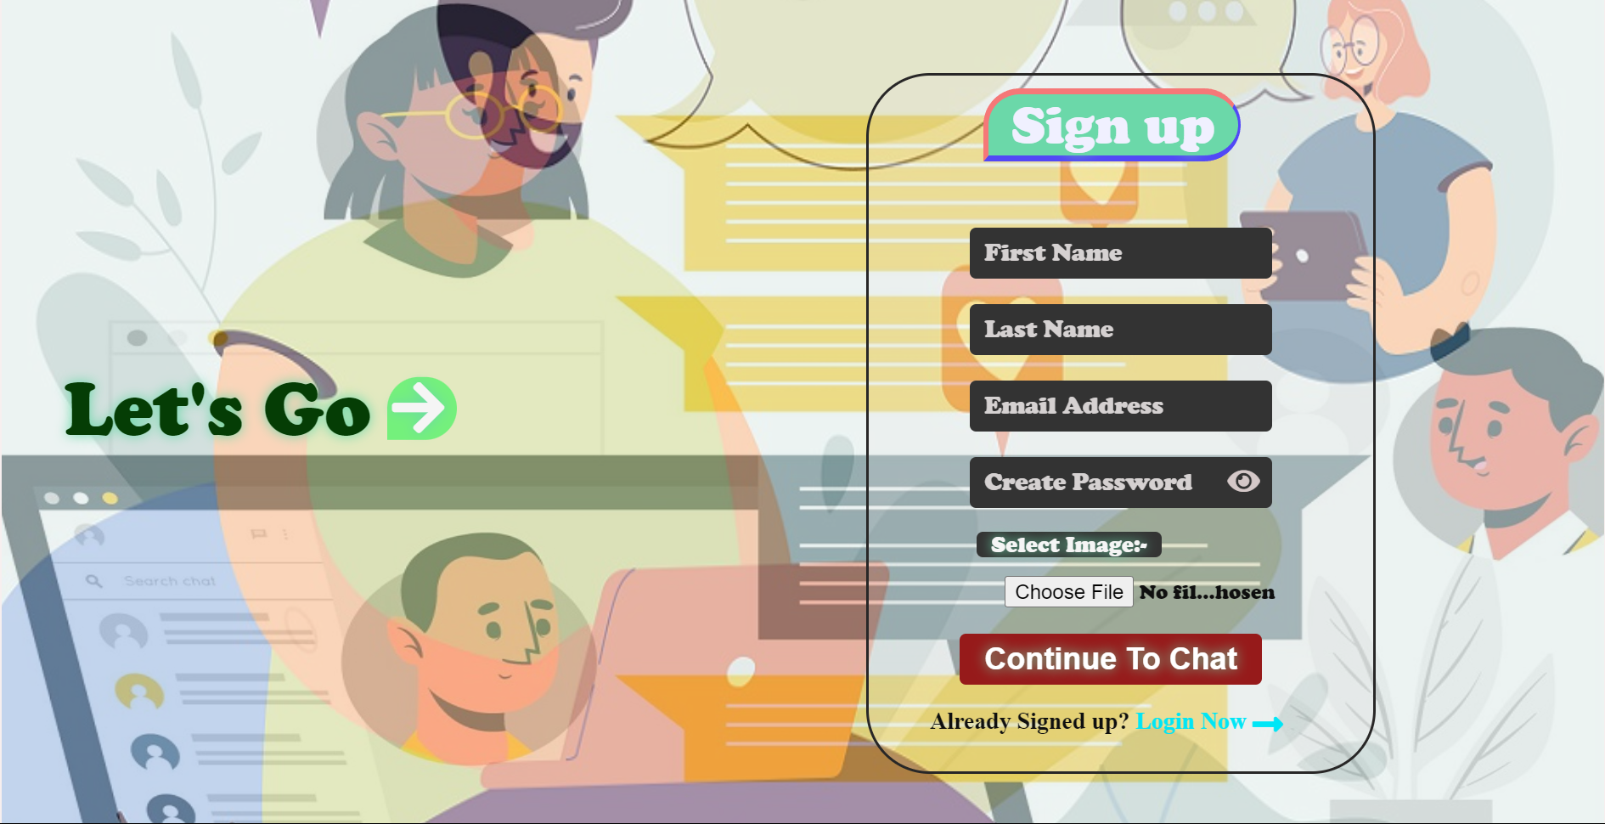
Sgin Up Page:-

Slide 17
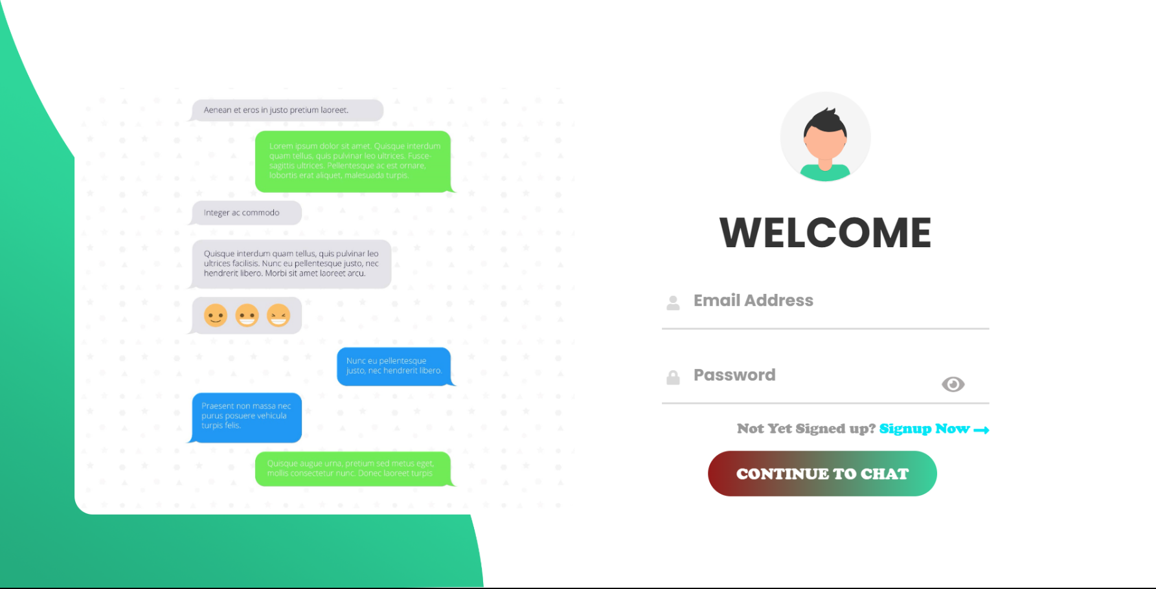
Login Page:-

Slide 18
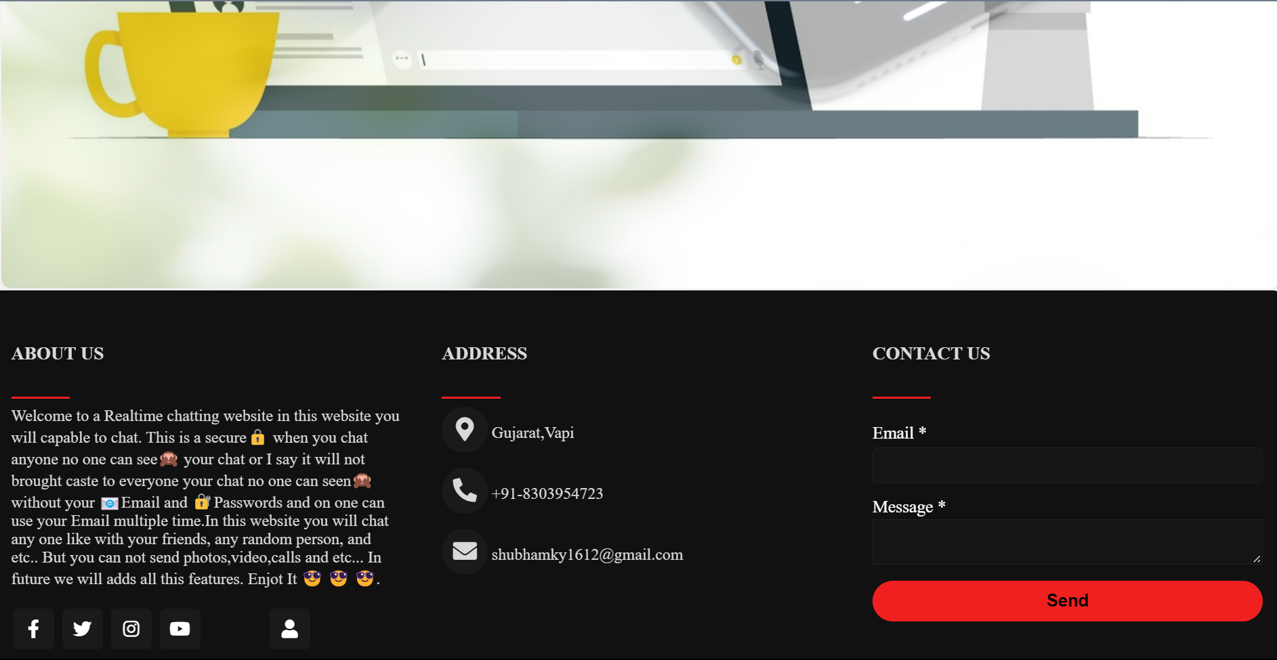
Footer Page:-

Slide 19
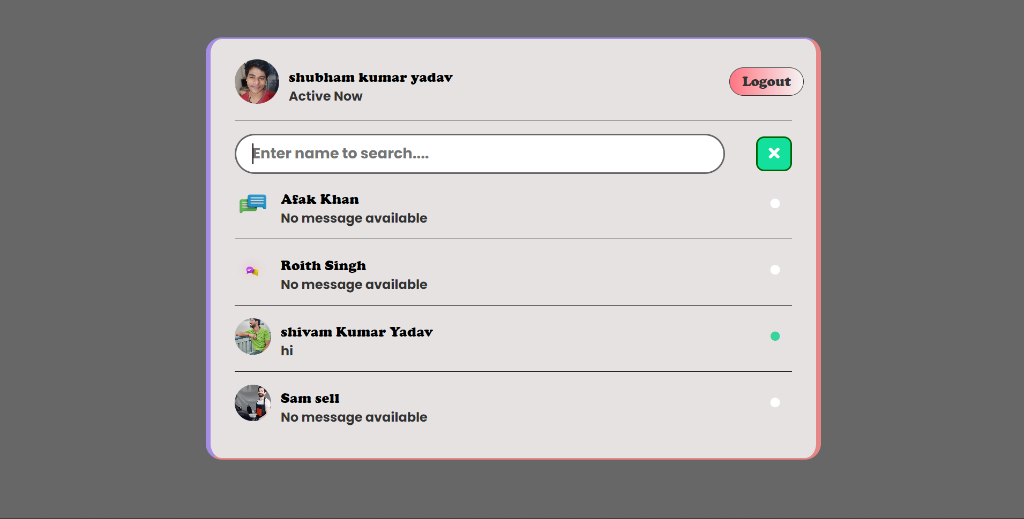
User Search Page:-

Slide 20
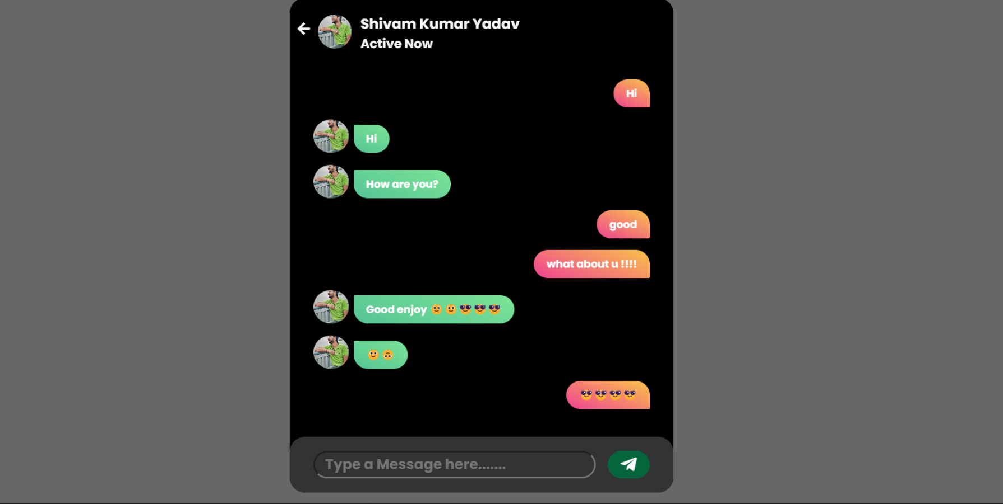
Chat Room Page:-

Slide 21
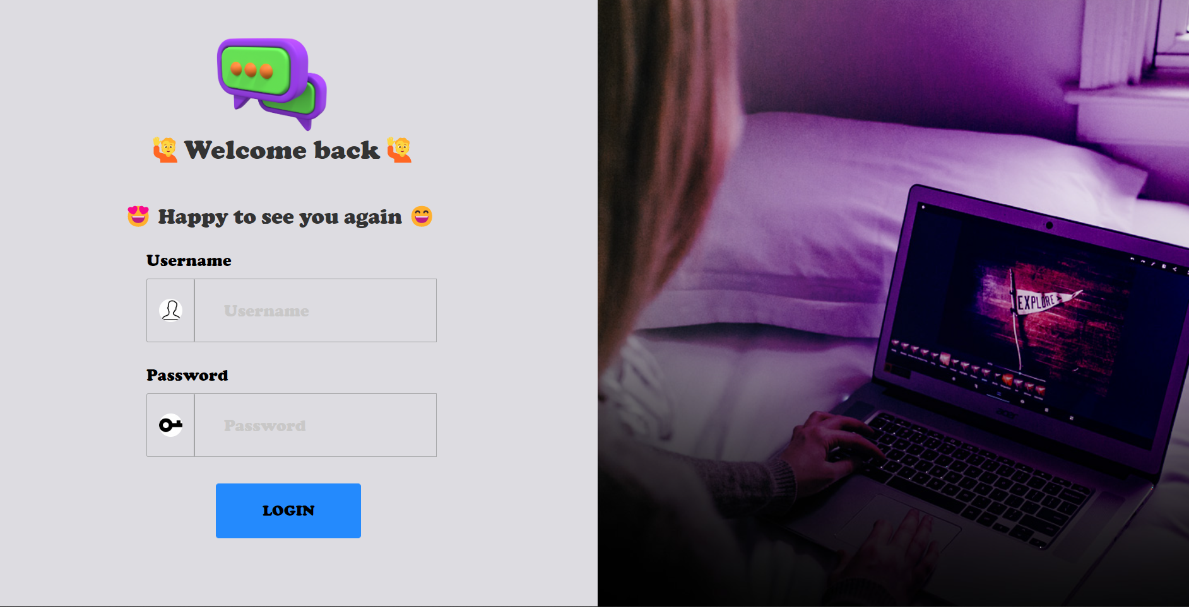
Admin Login Page:-

Slide 22
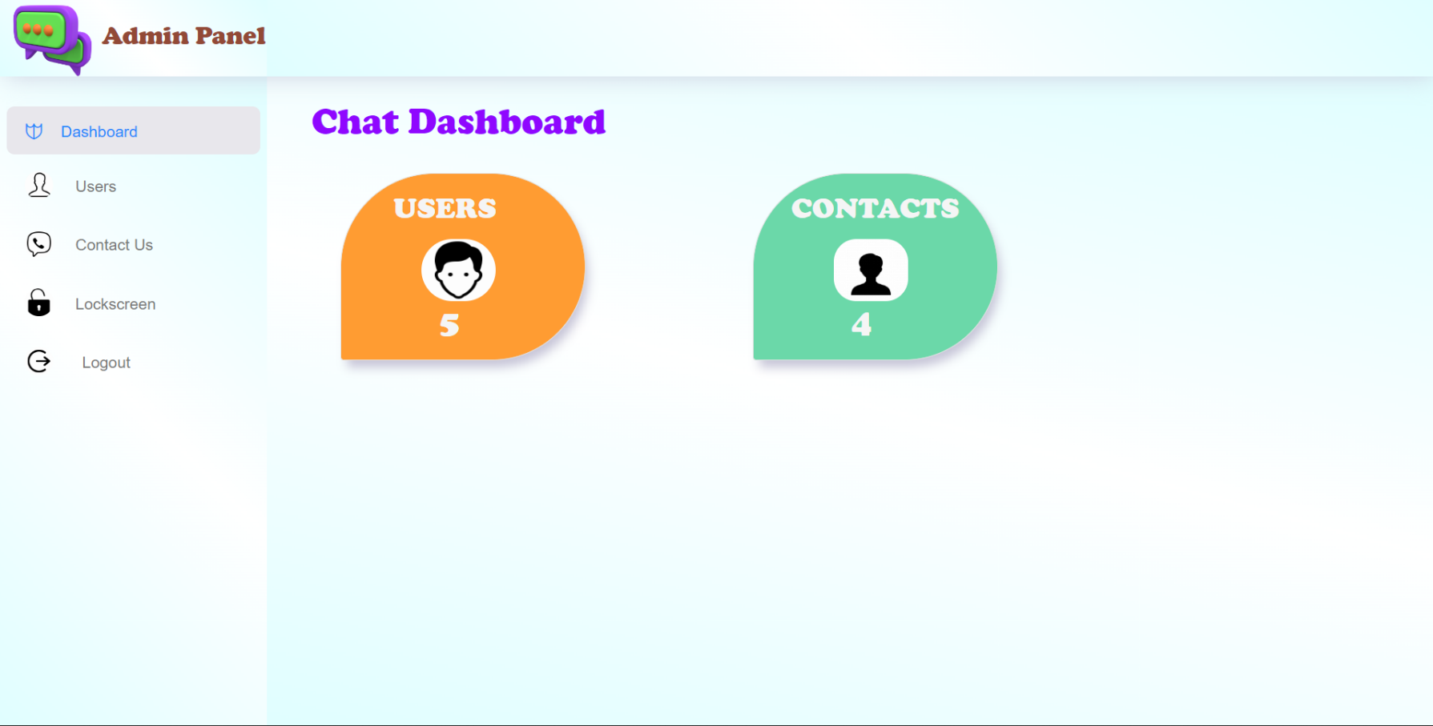
Admin Panel Page:-

Slide 23
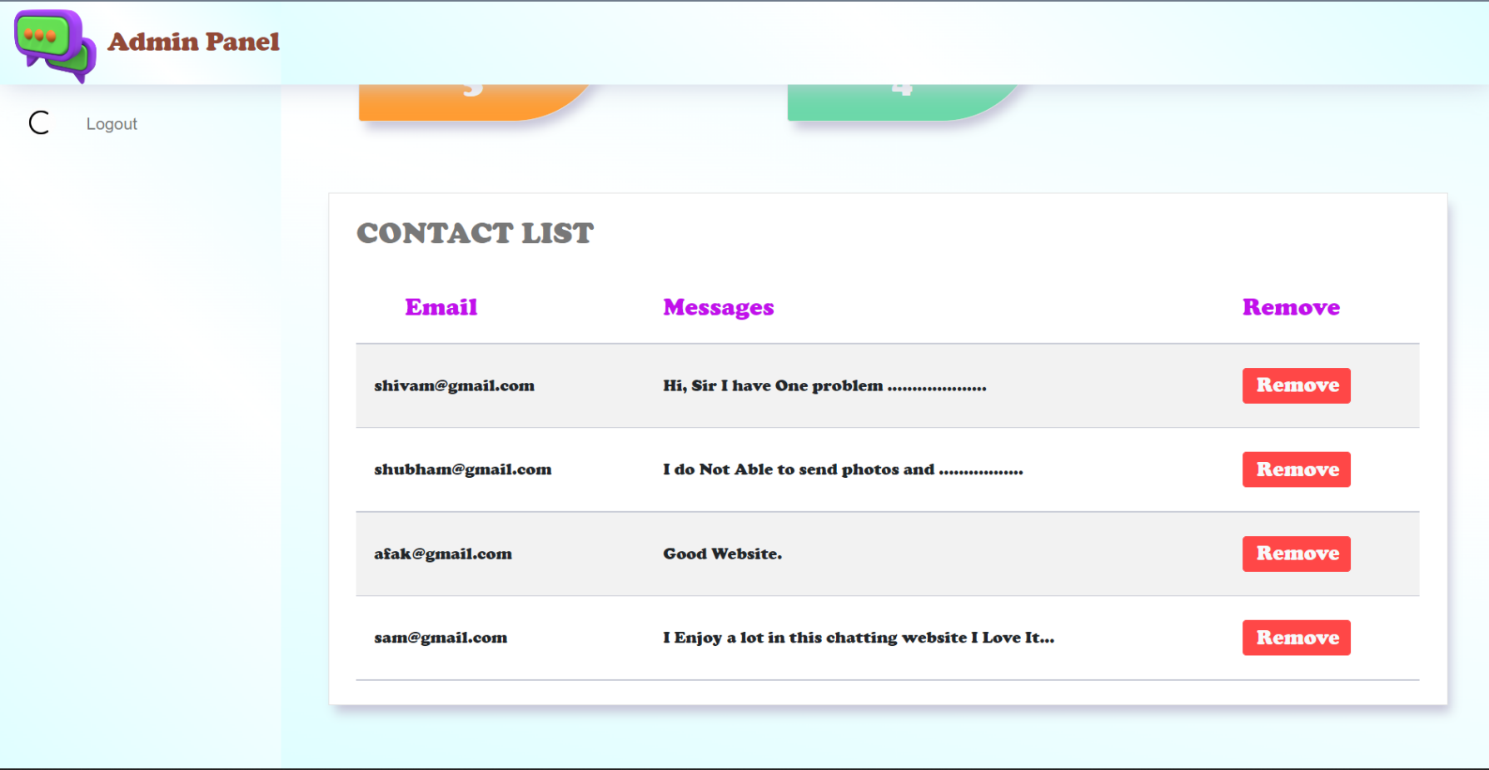
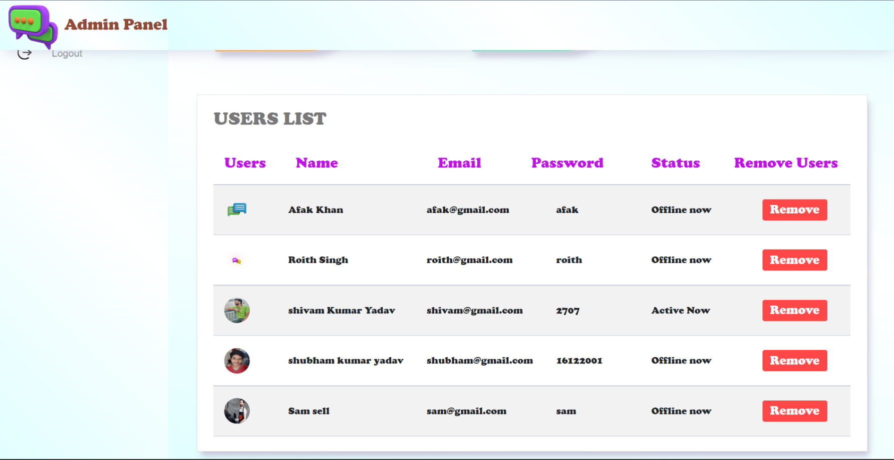

Slide 24
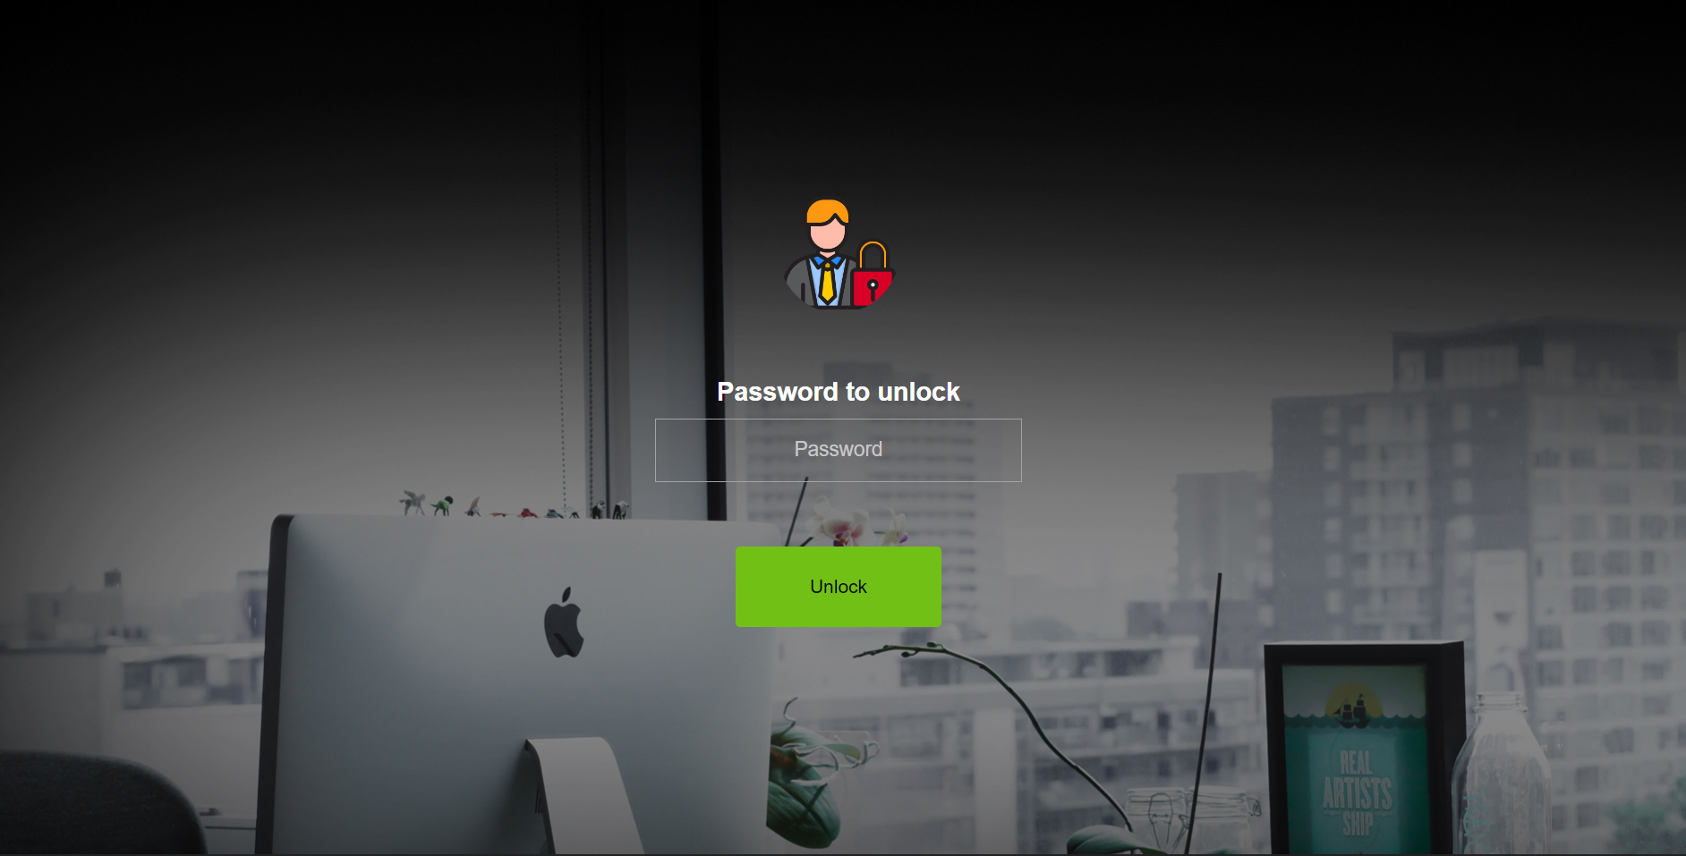
Lock Screen Page:-

Slide 25
FUTURE SCOPE
Future Scope:-
With the knowledge I have gained by
Developing this Web application, I am confident that in the future
I can make the Web application more effectively by adding this Services.
Video call.
Voice call.
Photos Sending.
Video Sending.
Voice Recording Chat.

Slide 26
References
https://www.w3schools.com/
https://www.freepik.com/
https://www.youtube.com/
https://www.javatpoint.com/

Slide 27
THANK You

